Slide 1
Digital Frameworks
Lesson 3
Medill on the Hill
Rachel Shorey
https://github.com/rshorey/digitalframeworks-spring18

Slide 2
Data stories

Slide 3
Assignment notes
In general assignment 1 looked good, if there was a particular issue I will get in touch with you via email.
You do not need to email me your homework link, as long as it’s in your github repo I will find it.

Slide 4
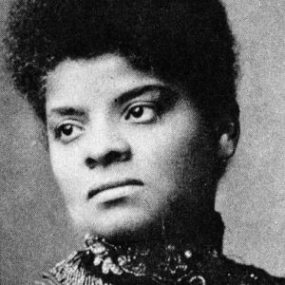
Data sets that don’t exist
Notes:
Ida B. Wells was not the first to keep track of something no one else was tracking. But she was incredibly impactful

Slide 5
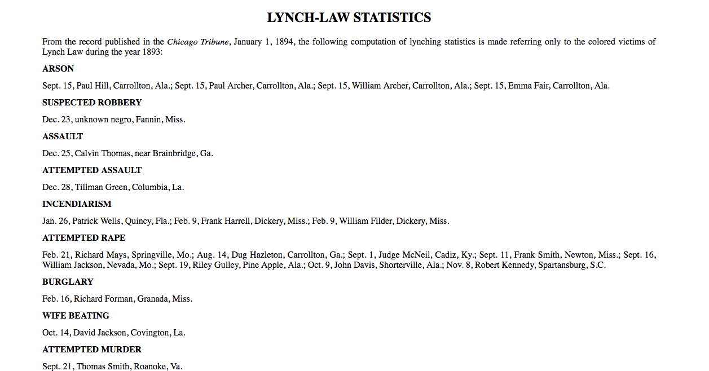
Data sets that don’t exist
Notes:
From Ida B. Wells book, “The Red Record.” These stats are pulled from the Chicago Tribune (and elsewhere other papers, which she specifically notes are white papers). The stories existed, what she did was create a data set.

Slide 6
Data sets that don’t exist
The rest of “The Red Record” is incredibly graphic descriptions of the circumstances of some of these lynchings, including in some cases photographs

Slide 7
Data sets that don’t exist
What Ida B. Wells did in “The Red Record” is the gold standard in many ways:
Find a trend
Gather a dataset that indicates the scope
Flesh out some individual stories

Slide 8
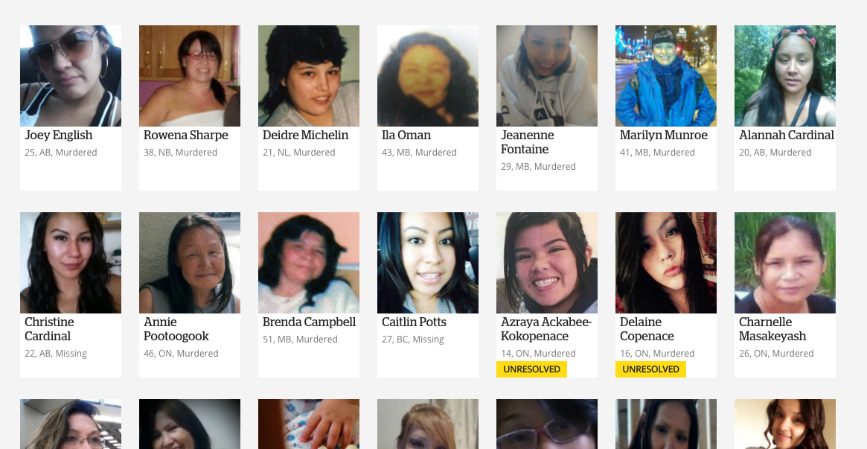
Data sets that don’t exist
Notes:
CBC’s missing and murdered indigenous women project: they collected the data to document the scope of the trend...

Slide 9
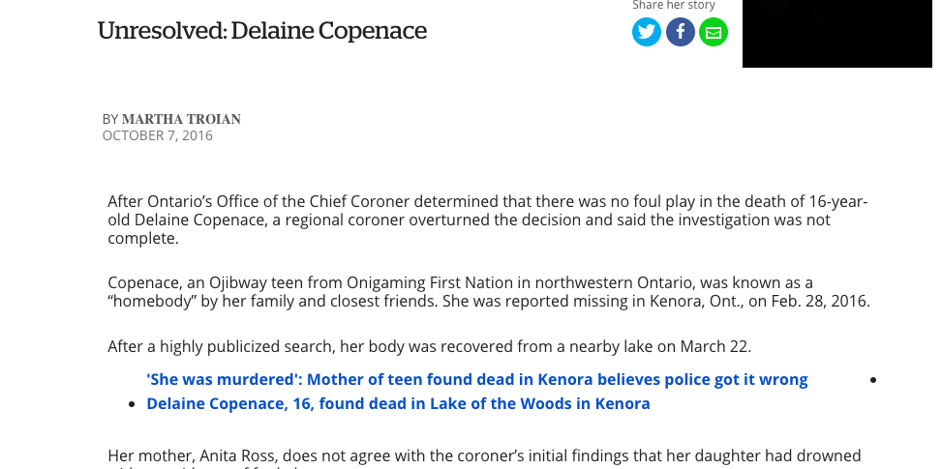
Data sets that don’t exist
Notes:
...they told individual stories...

Slide 10
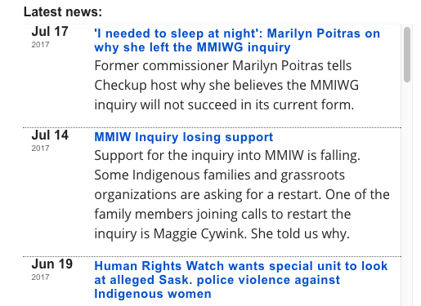
Data sets that don’t exist
Notes:
...and they continue to document

Slide 11
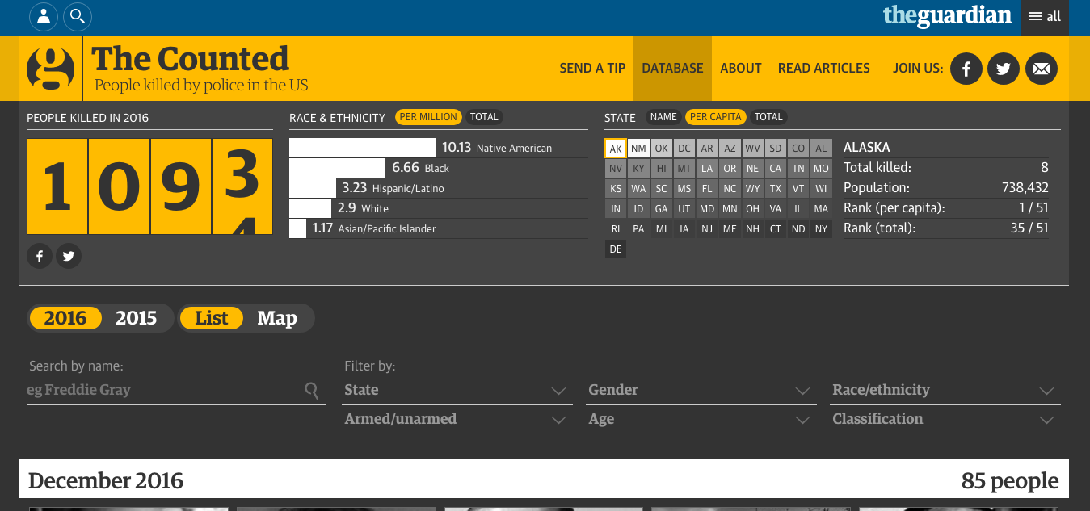
Data sets that don’t exist
Notes:
Guardian’s police shooting dataset (The Post did this, too, as we know, but this one did a better job of then telling some stories, IMO)

Slide 12
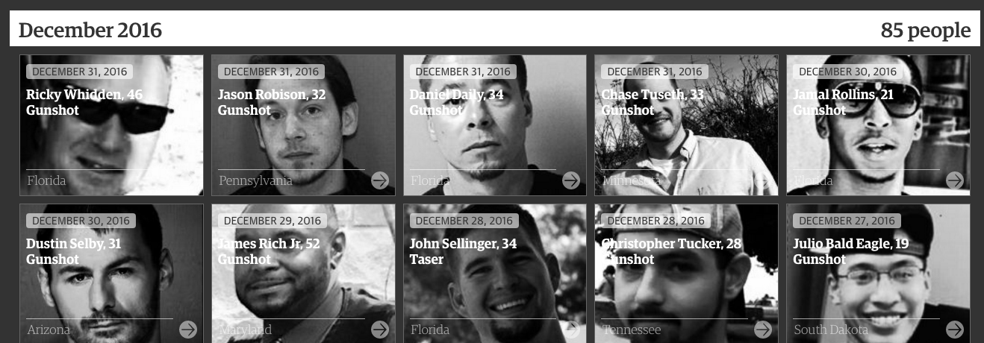
Data sets that don’t exist
Notes:
Document the trend...

Slide 13
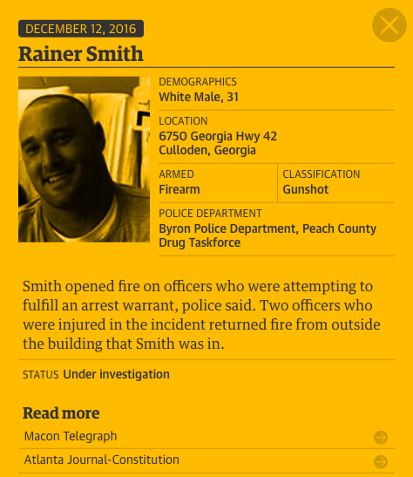
Data sets that don’t exist
Notes:
...tell the individual story...

Slide 14
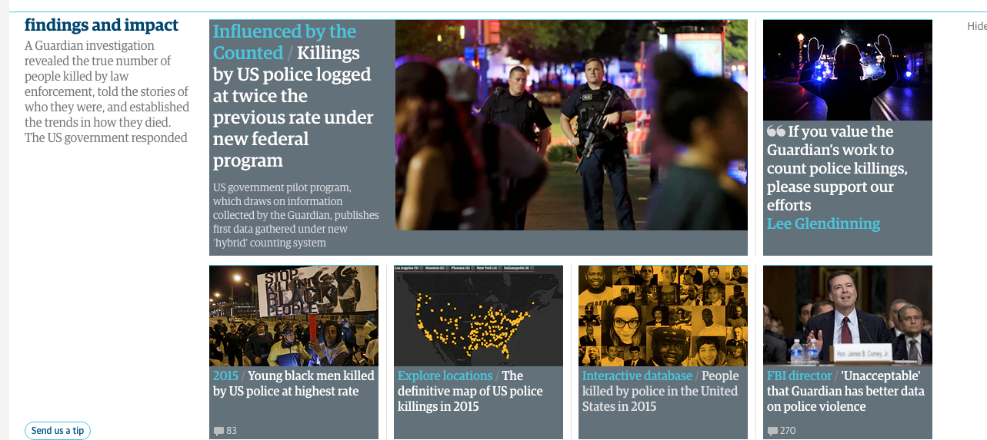
Data sets that don’t exist
Notes:
...continue to cover.

Slide 15
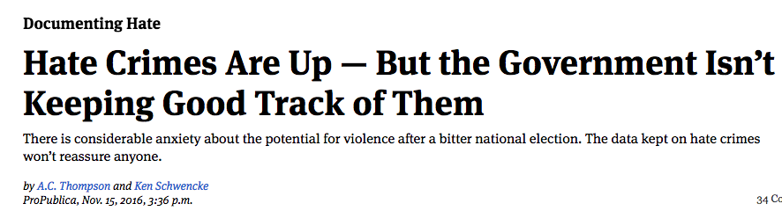
Data sets that don’t exist
Notes:
ProPublica’s documenting hate project
Identify the trend...

Slide 16
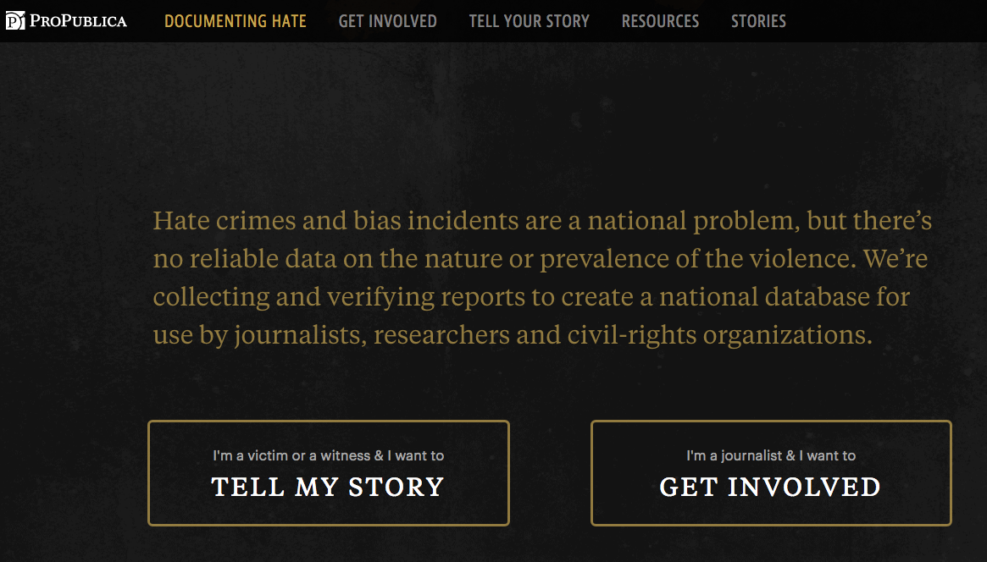
Data sets that don’t exist
Notes:
...track the problem...

Slide 17
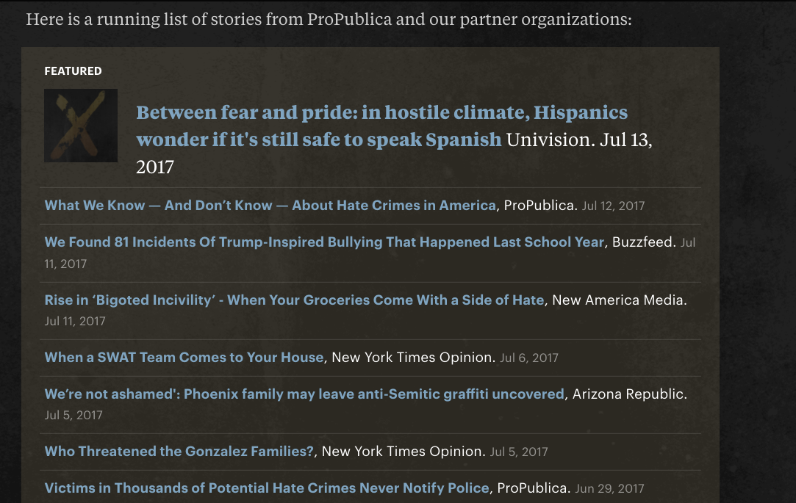
Data sets that don’t exist
Notes:
...tell the story

Slide 18
Data sets that don’t exist
But I don’t have a team of software developers, data scientists and reporters to work on the dataset I want!
Notes:
The examples I gave are all pretty high profile and required a lot of technological work.
You don’t need that.

Slide 19
Data sets that don’t exist
Here are some things I’m currently tracking:
Special Elections - I have a google alert on the term “special election” and I just put them in a sheet whenever I hear about a new one
NYT stories about health care that quote regular people (not experts)
Notes:
These aren’t high profile, but they’re datasets that otherwise don’t exist (the second is so that we can go back and check in on people later)

Slide 20

Data sets that don’t exist
Data tracking anyone can do:
Elected officials are pushing a new initiative that they say will make money. Write down every statement you hear about how much money it will make. Check in next year.
Notes:
Example: a casino.
The Daily Show is really good at “assemble a dataset of every time someone said something about X”

Slide 21

Data sets that don’t exist
Data tracking anyone can do:
Every time a news story mentions someone who is a Mar-a-Lago member, write that down!

Slide 22
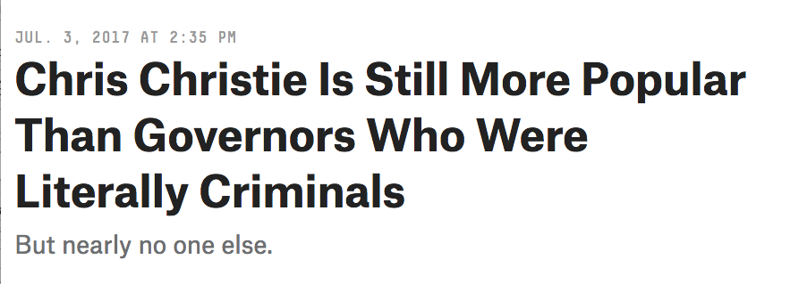
Data sets that don’t exist
Notes:
We discussed this one recently (from 538)

Slide 23
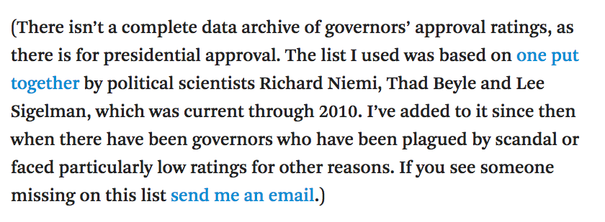
Data sets that don’t exist
Notes:
We discussed this one recently…

Slide 24
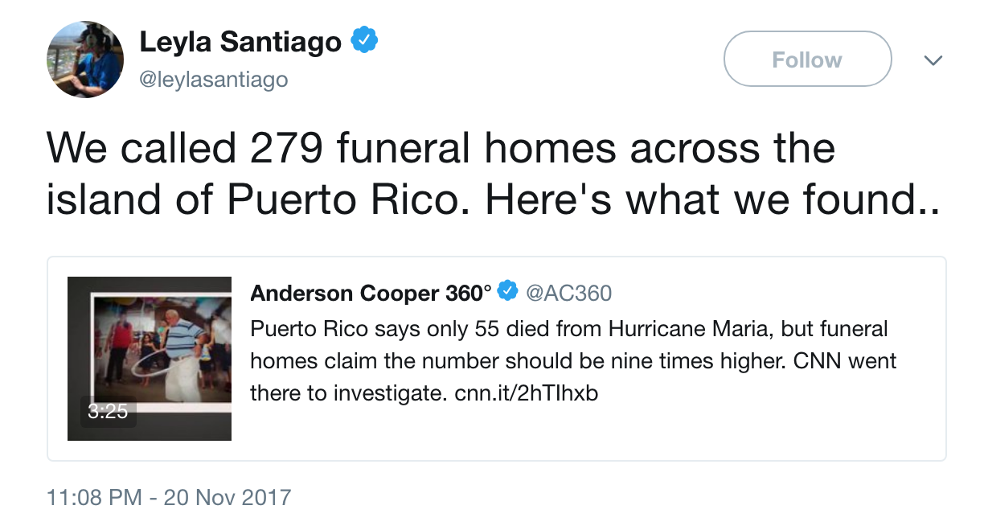

Slide 25
Sharing data
It feels wrong to share your own data
Notes:
Why?
*you might get scooped with your own data
*someone might analyze it differently, and get in a big fight with you
*if there’s something wrong with your data, someone else might blame you or yell at you
*what if we don’t want to maintain it anymore and people are depending on it?

Slide 26
Sharing data
It feels wrong to use someone else’s data
Notes:
Why?
*”we can do our own work, we don’t want to have to cite someone else”
*”do we trust them?”
*”what if they shut it off?”

Slide 27
Sharing data
But in a big data world, we need to do it.
We just don’t have the capacity for every news outlet to do everything alone
If we want people to trust us, we need to let them see the raw data
Notes:
Unambiguously, we will all tell better stories if we share our data.

Slide 28
Sharing data
Case Study: Trump inaugural donors

Slide 29
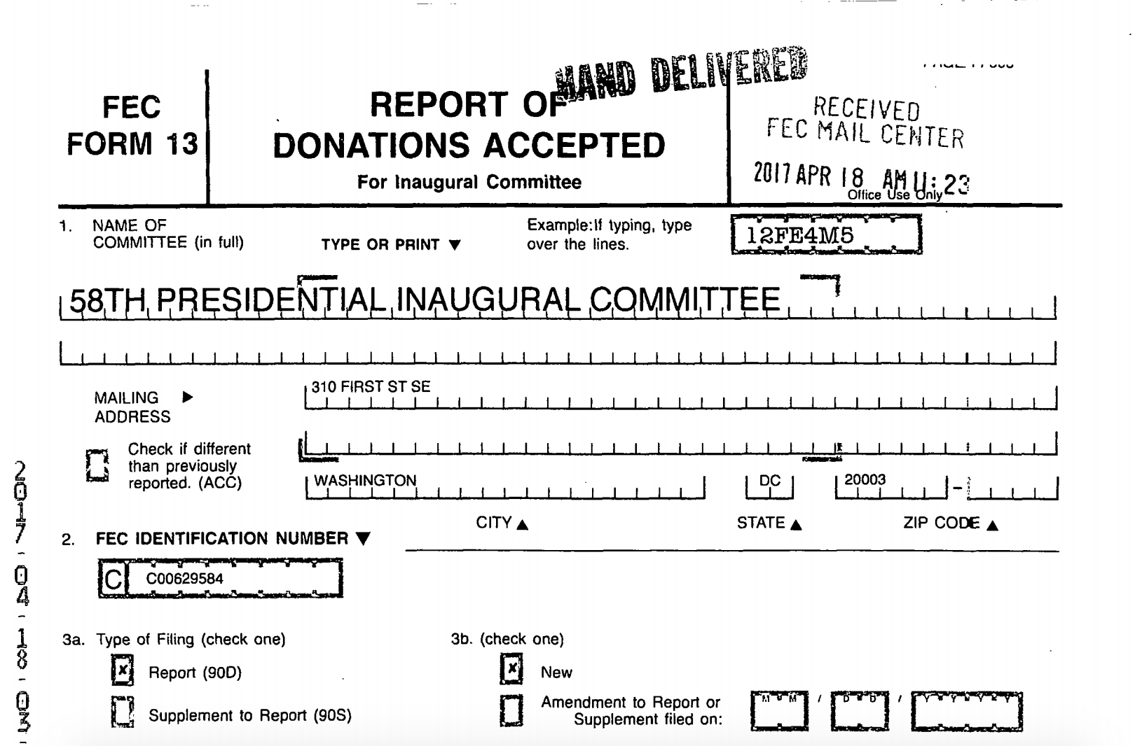
Sharing data
Notes:
This is Trump’s inaugural committee’s filing. It was generated by a campaign finance filing software. They could have just used the software to submit it electronically. They decided instead to hit the print button and hand-deliver the filing to the FEC, which scanned it and put it on the internet (the previous 2 inaugural committees submitted electronically)

Slide 30
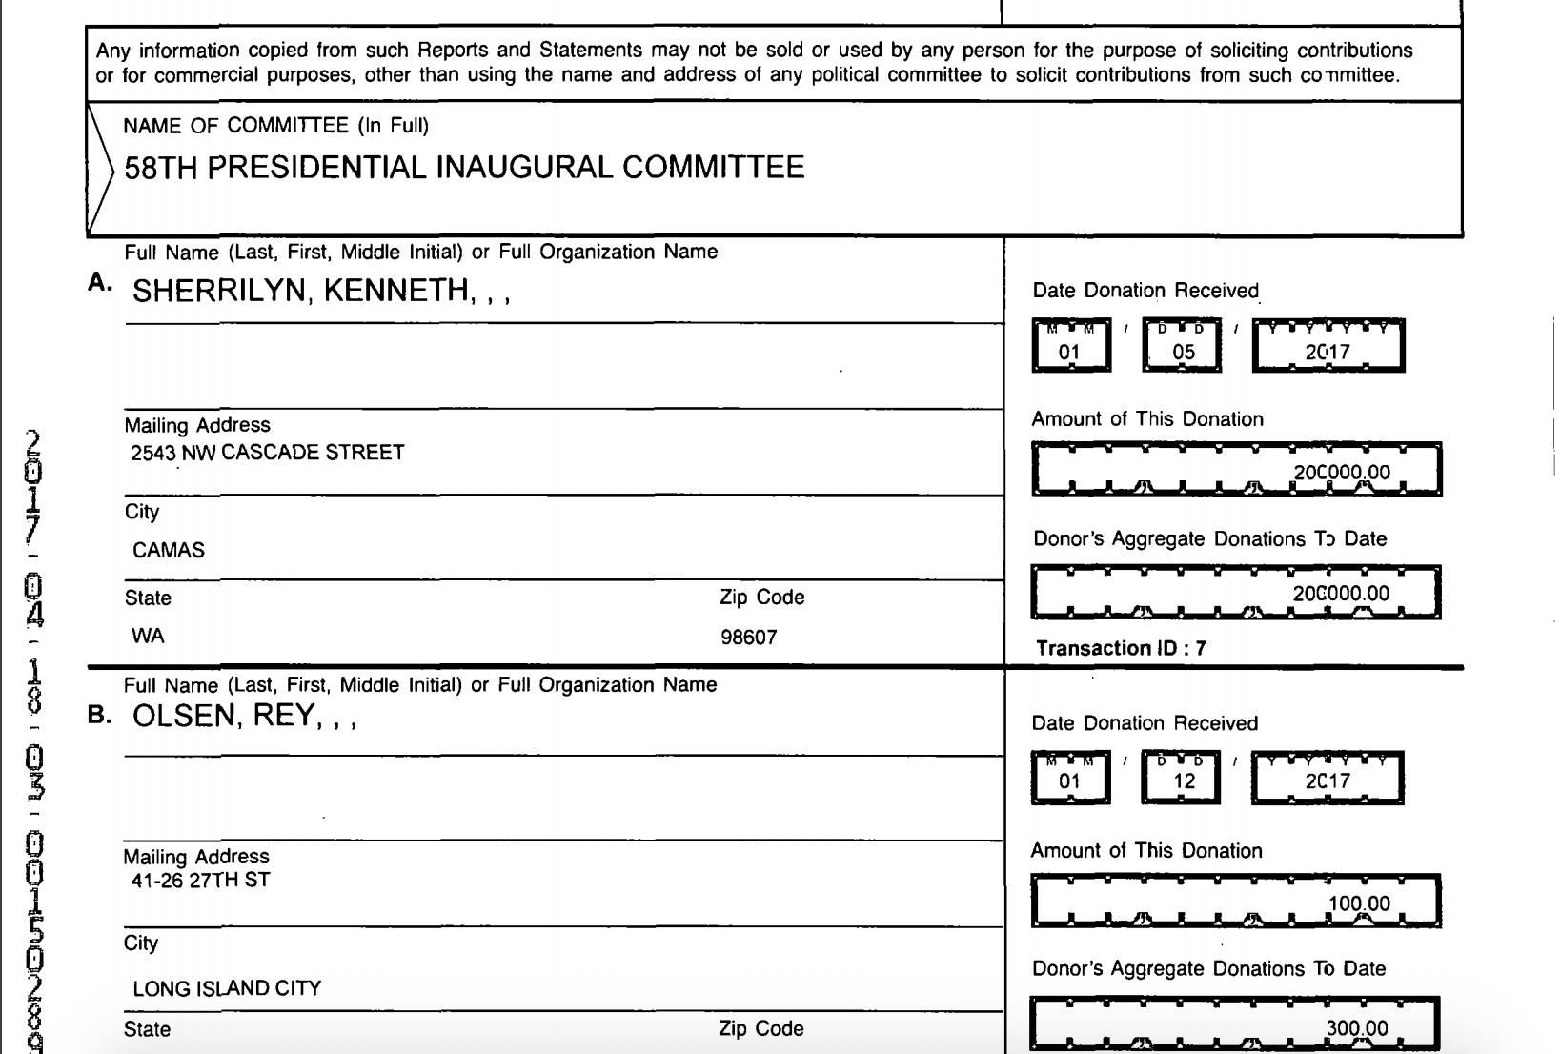
Sharing data
Notes:
Here’s a page.
Every major national news organization was going to dig into this. Why should we all do it separately if we’re definitely going to do the same thing?

Slide 31
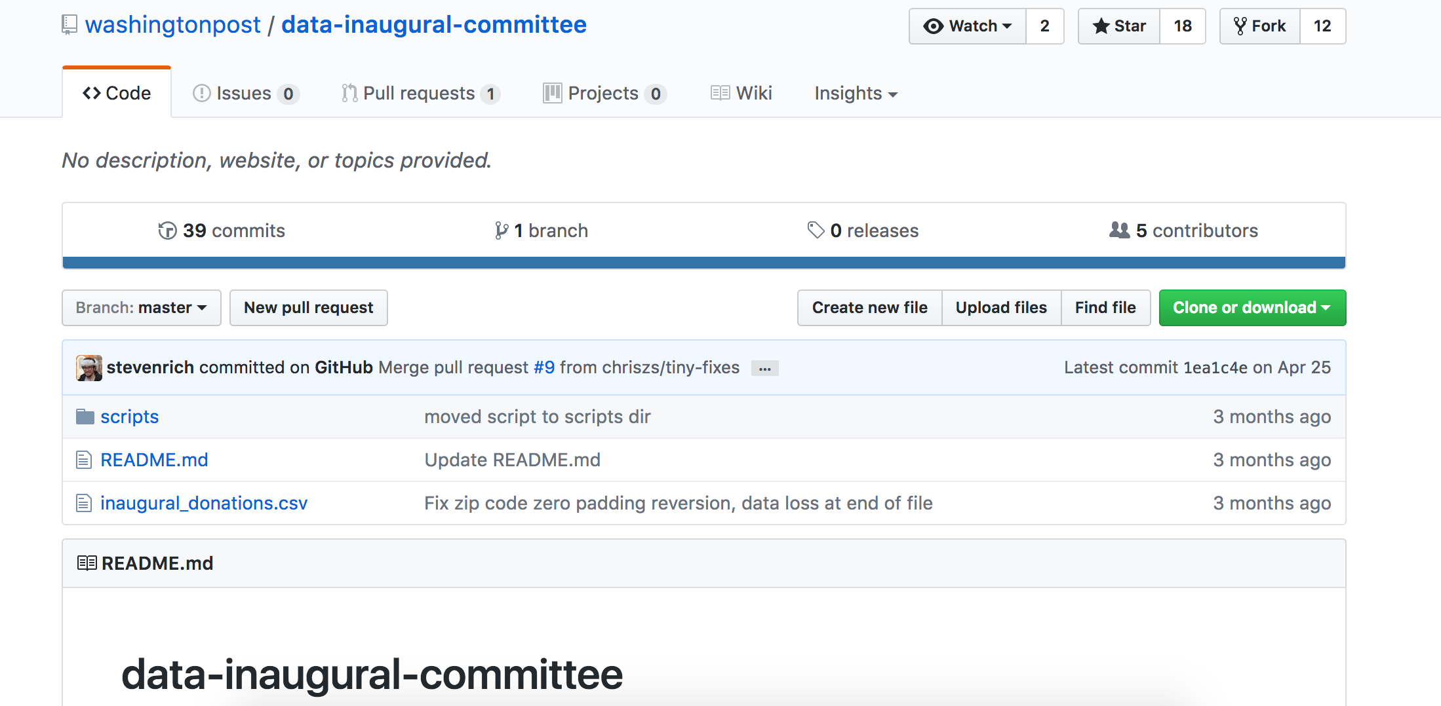
Sharing data
Notes:
So Steven Rich started processing the data on github in public

Slide 32
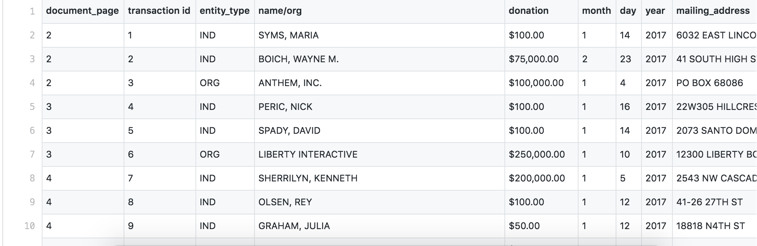
Sharing data
Notes:
...in machine-readable format.

Slide 33
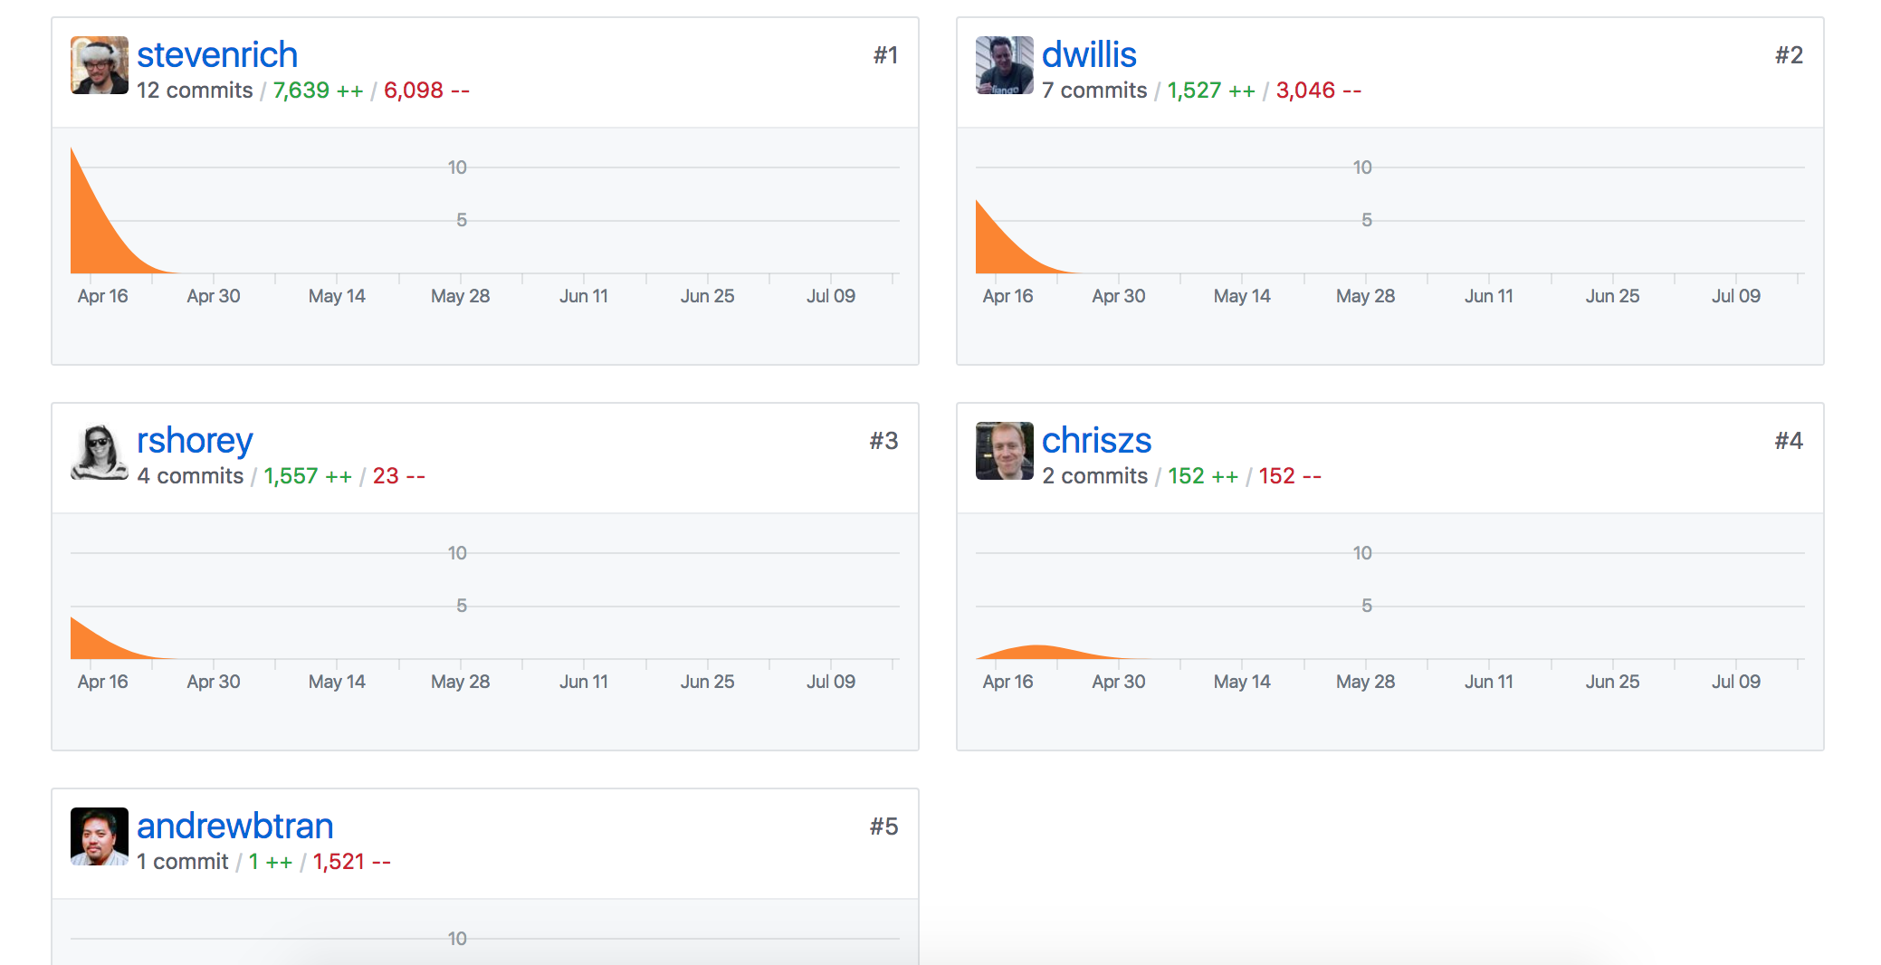
Sharing data
ProPublica
WaPo
NYT
Center for Public Integrity
CT Mirror
Notes:
And others chipped in

Slide 34
Sharing data
Notes:
...in machine-readable format.

Slide 35
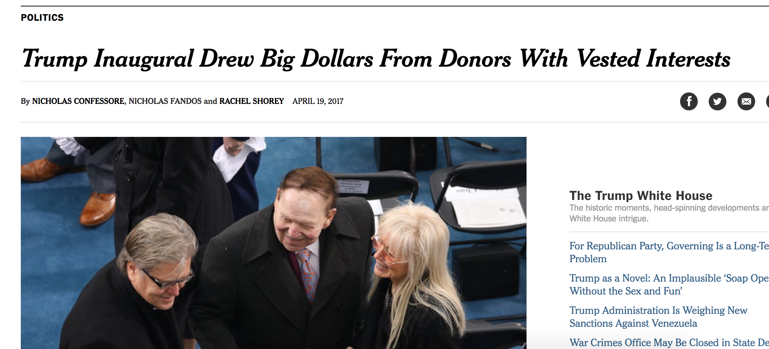
Sharing data
Notes:
Everyone wrote stories

Slide 36
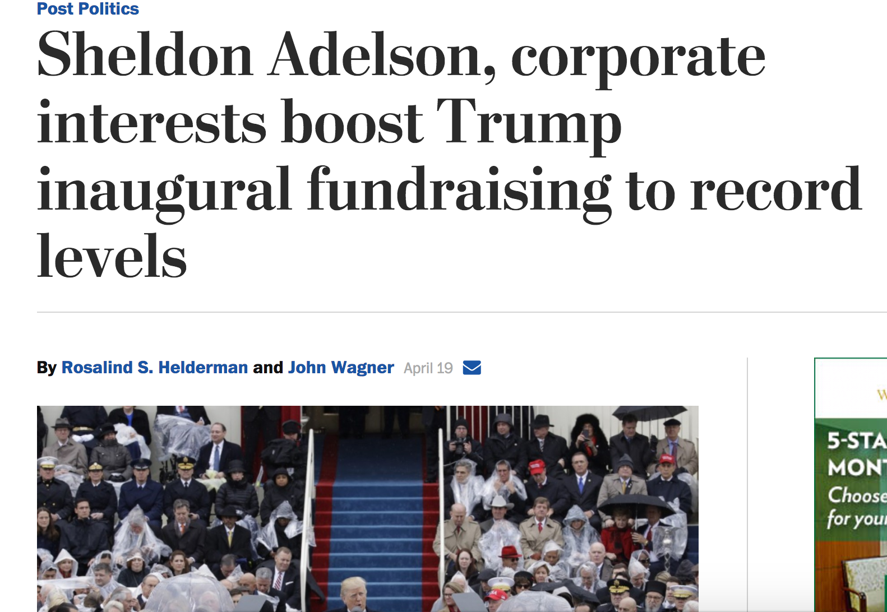
Sharing data
Notes:
Everyone wrote stories

Slide 37
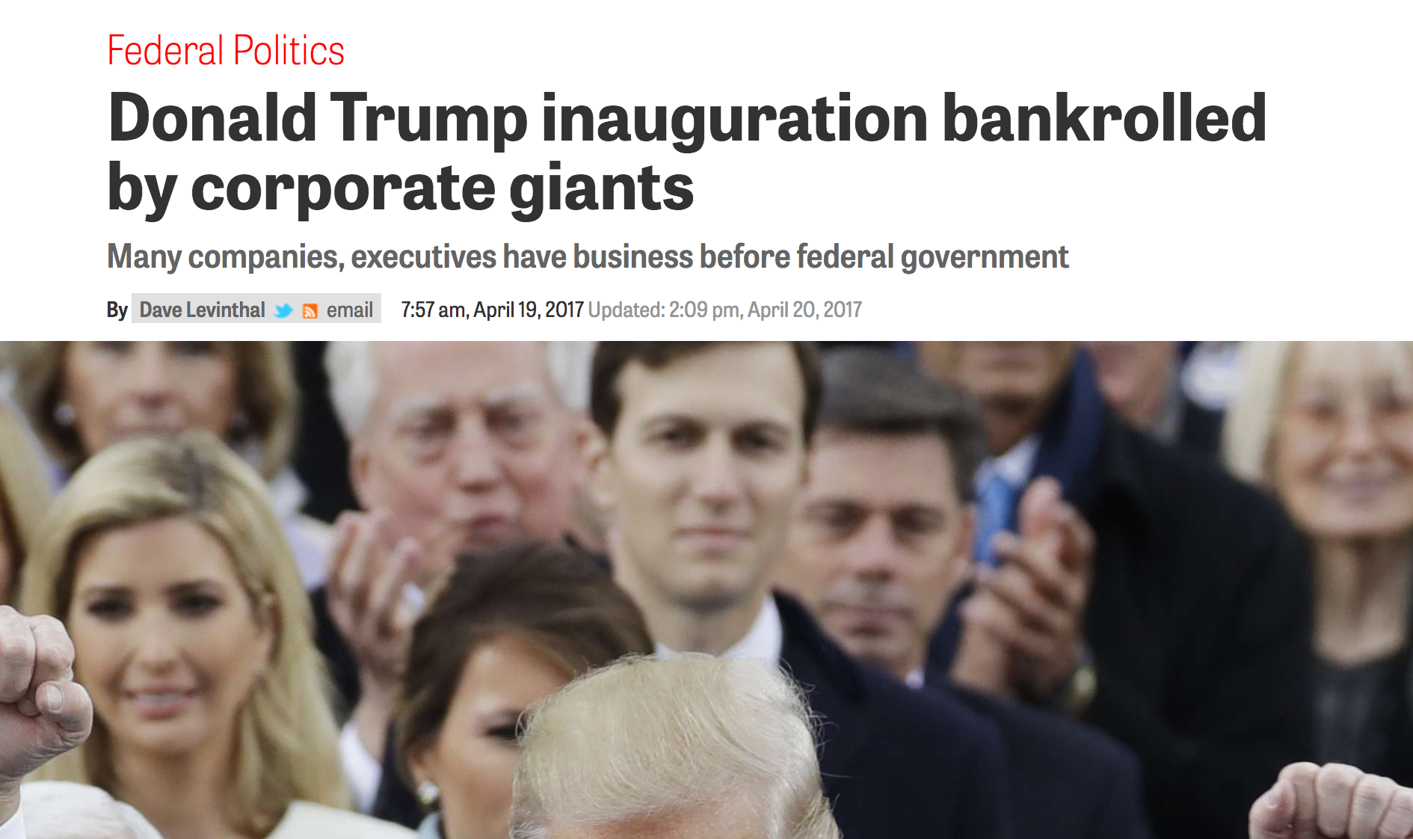
Sharing data
Notes:
...and I could go on

Slide 38
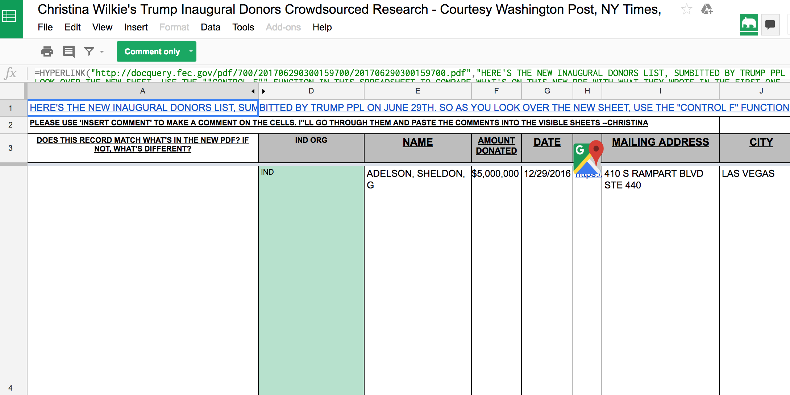
Sharing data
Notes:
Christina Wilke, then of Huffington Post, put this data in a google sheet and crowd-sourced additional information about these individuals

Slide 39
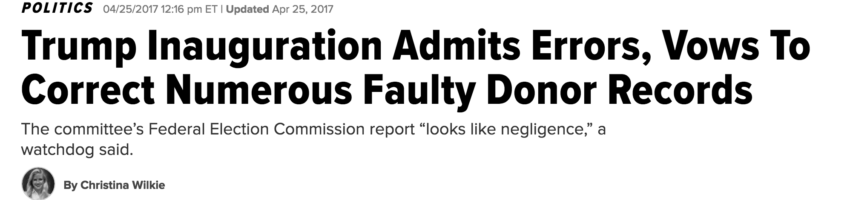
Sharing data
Notes:
Christina Wilke, then of Huffington Post, put this data in a google sheet and crowd-sourced additional information about these individuals

Slide 40
Sharing data
Case Study: ProPublica Machine Bias

Slide 41
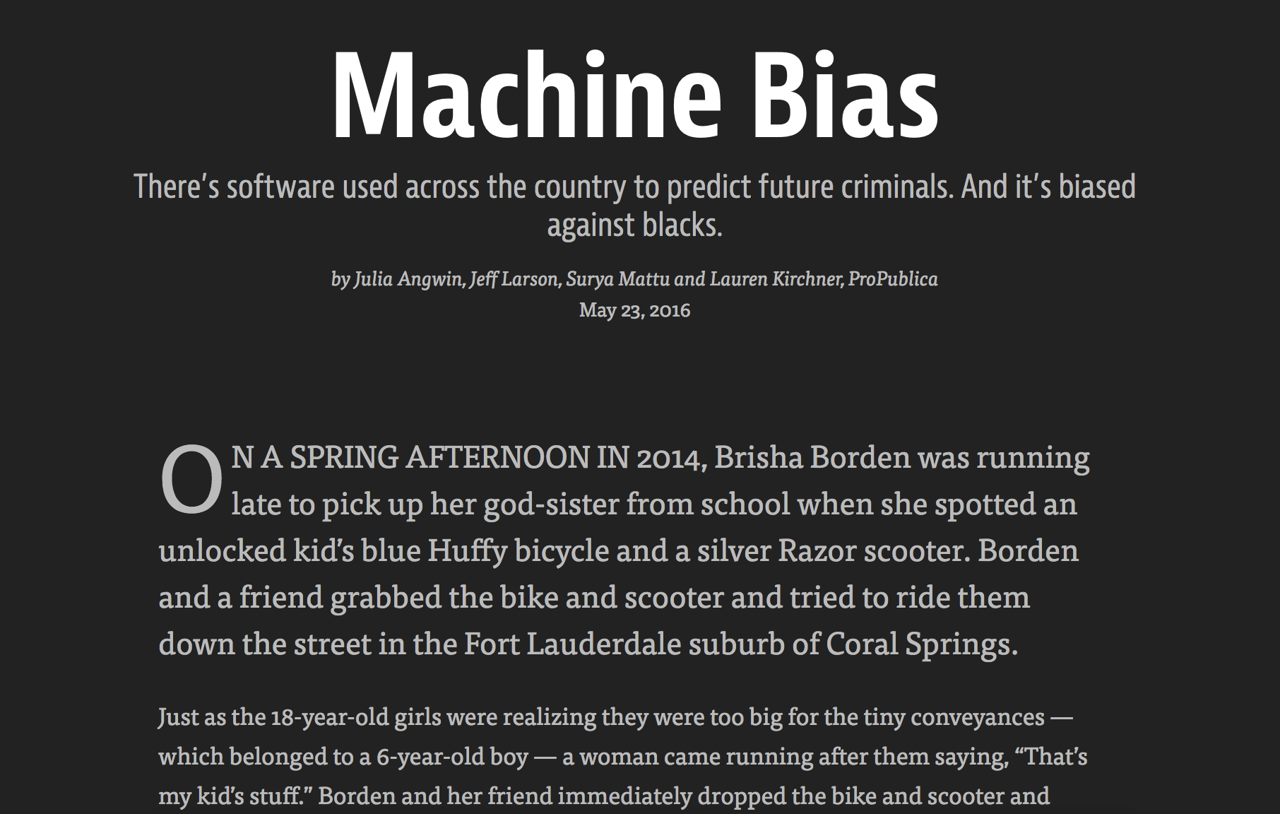
Sharing data
Notes:
ProPublica looked at an algorithm that predicts how likely an offender is to re-offend. (This algorithm can have consequences in sentencing and prison treatment)

Slide 42
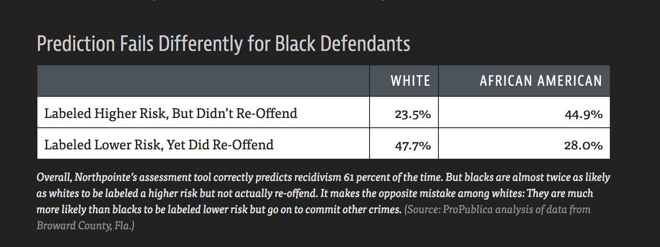
Sharing data
Notes:
This is the meat of the story’s point. The idea is that the algorithm is wrong the same amount of the time about black offenders and white ones. That is, people of different races had about the same chance of being put in the wrong category. But white offenders were much more likely to wrongly be labeled as low risk to re-offend, while black offenders were more likely to be incorrectly labeled as at high risk of re-offending

Slide 43
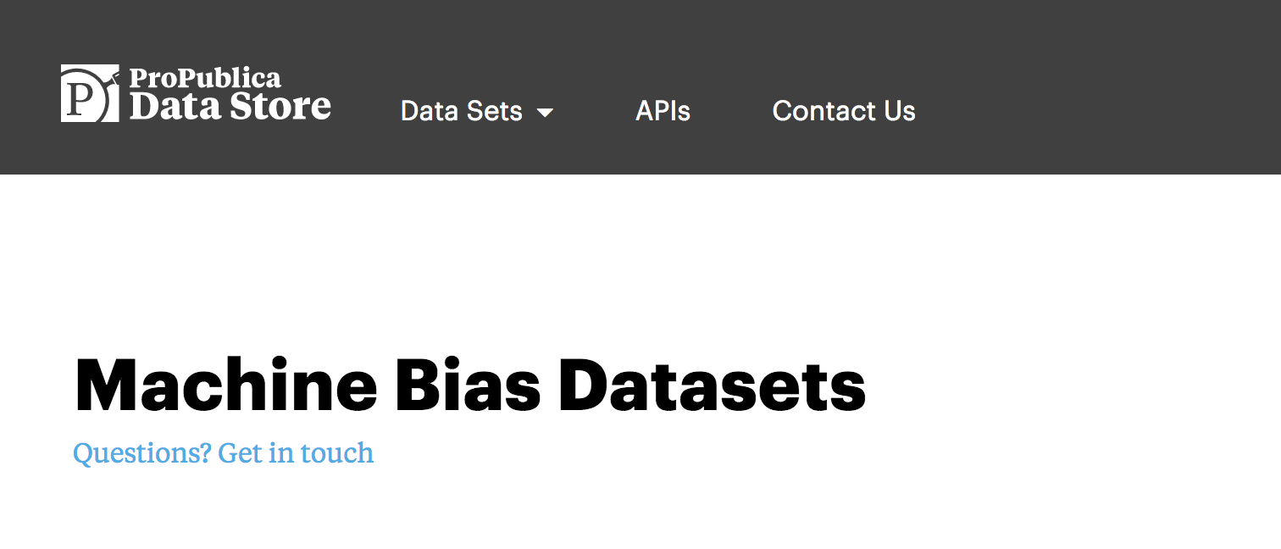
Sharing data
Notes:
ProPublica has a thing called a “data store” where they give away or sell datasets.

Slide 44
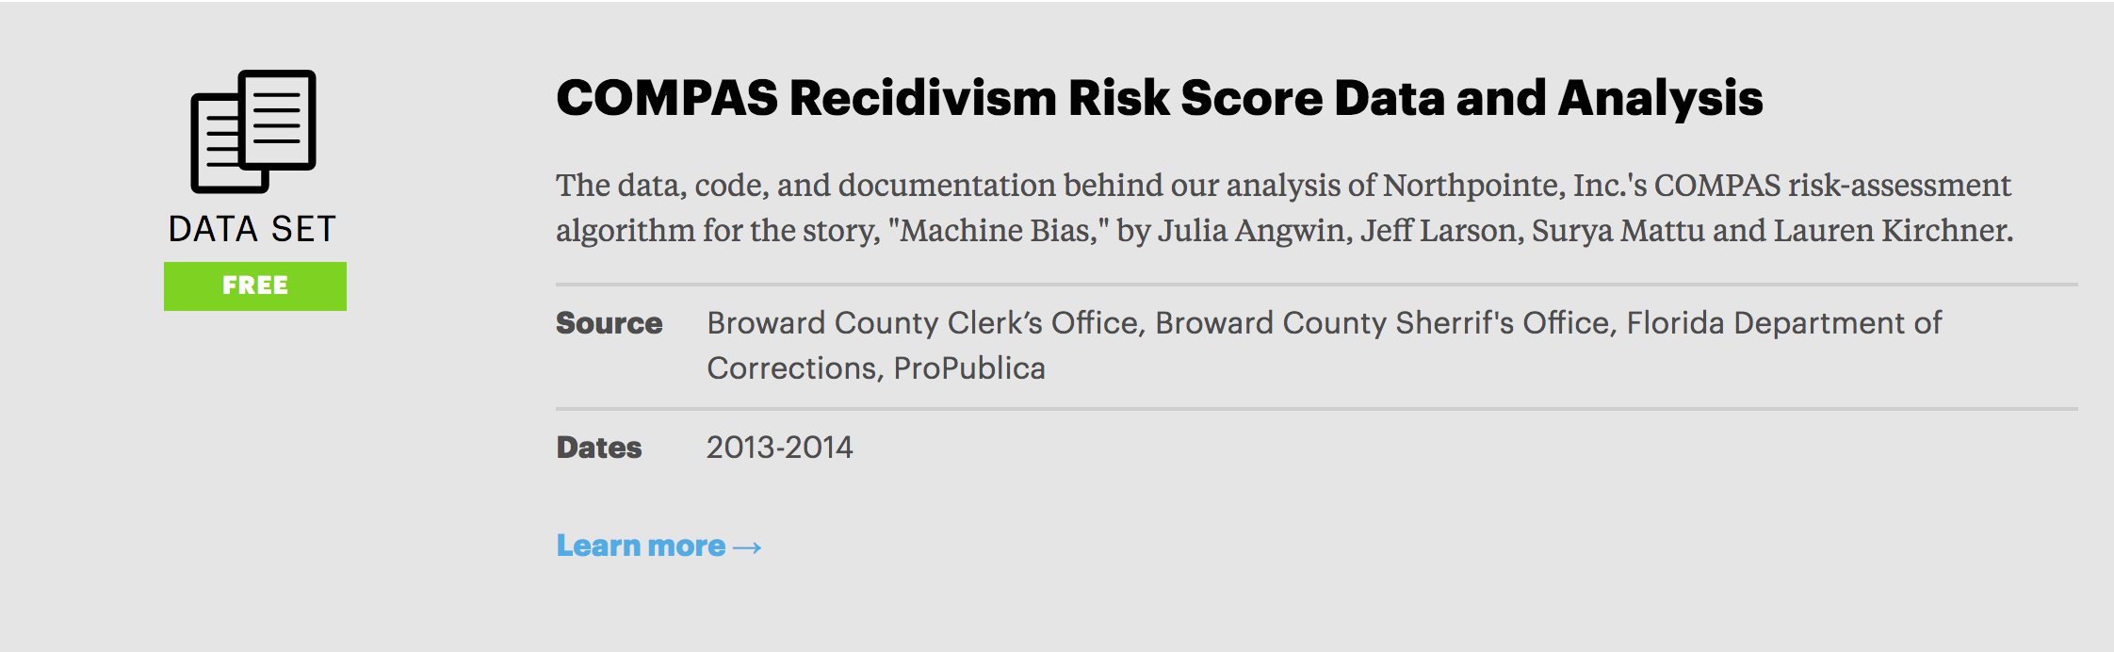
Sharing data
Notes:
This one was free

Slide 45
Sharing data
Notes:
This one was free

Slide 46
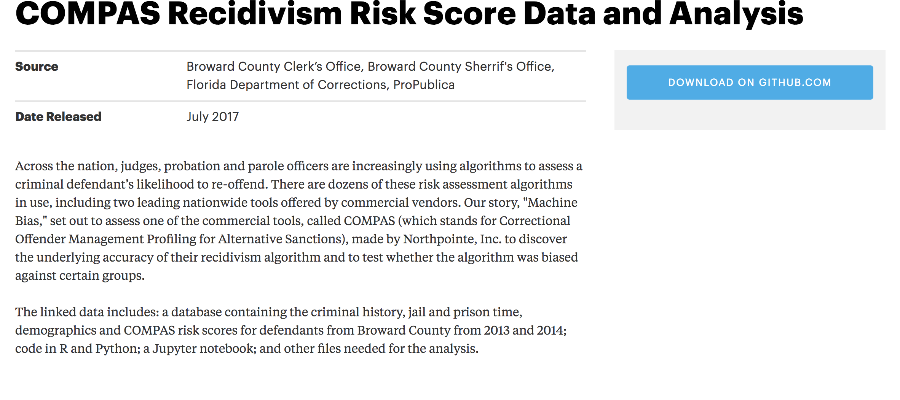
Sharing data
Notes:
Side note: very helpful documentation

Slide 47
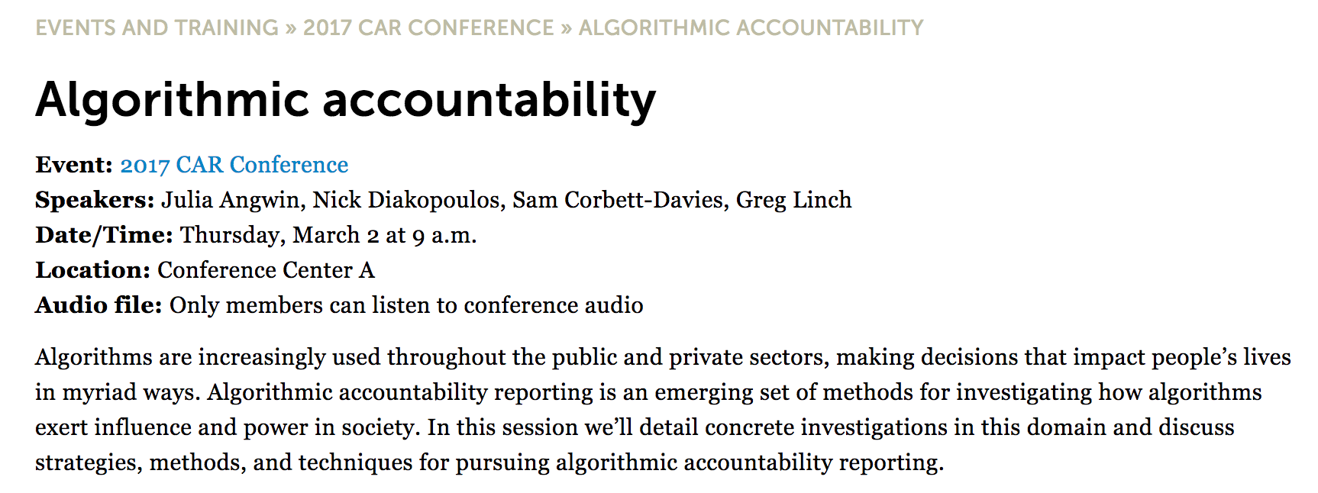
Sharing data
Notes:
A LOT of people downloaded the data and played around with it. This is from NICAR’s 2017 conference, an annual get-together for folks in Computer Assisted Reporting. This entire panel was entirely about this story, and people who had re-analyzed the data and come to different conclusions

Slide 48
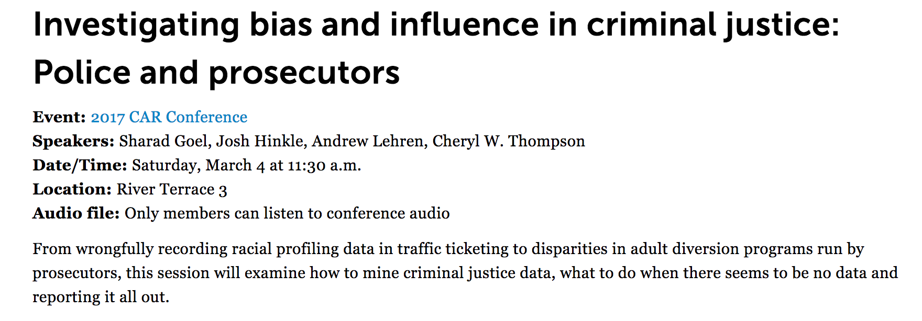
Sharing data
Notes:
And in case that wasn’t enough, this session turned into the same thing (and almost turned into a brawl)

Slide 49
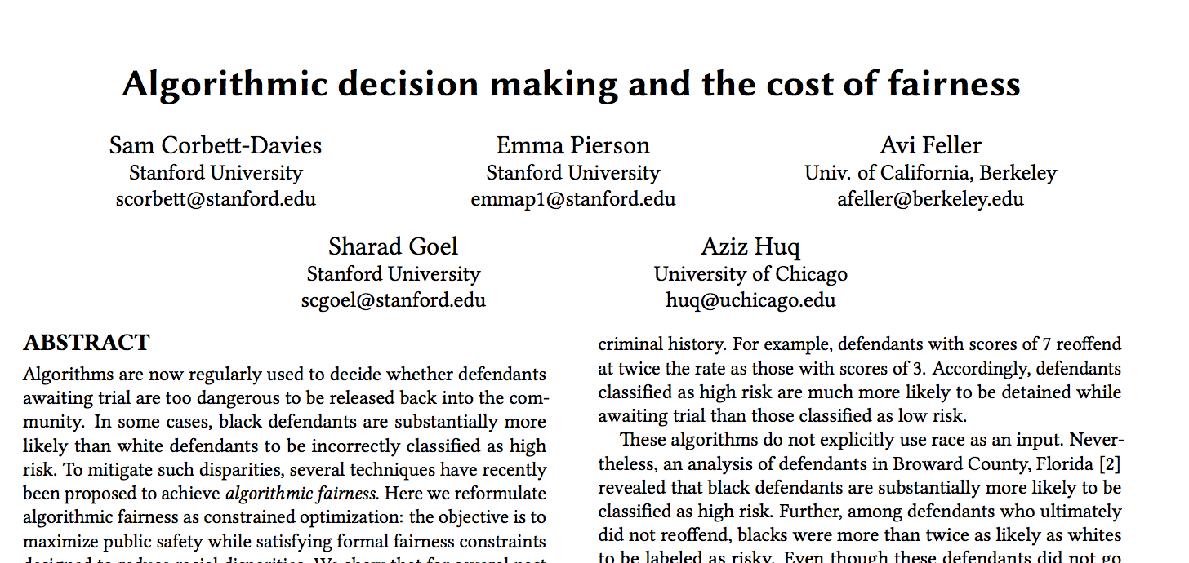
Sharing data
Notes:
People are writing academic papers based on this dataset

Slide 50
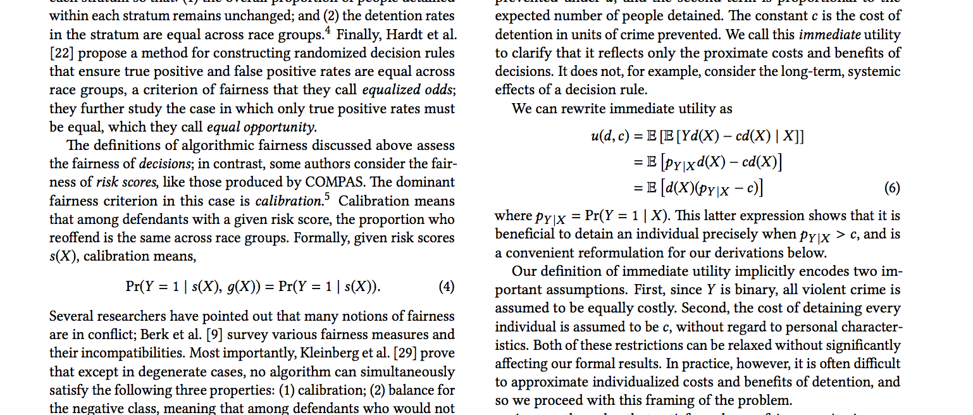
Sharing data
Notes:
...like, ones with lots of equations and greek letters

Slide 51
Sharing data
Case Study: ProPublica Machine Bias
Summary: ProPublica wrote a high impact story. They released their data. Academics started talking and arguing about it. It’s making its way into academic research that will impact the way this sort of thing is done in the future...

Slide 52
Sharing data
Case Study: ProPublica Machine Bias
...and it’s started a conversation among some computer scientists about the very definition of the word “bias”
Notes:
Kind of hard to do better than that!

Slide 53
Sharing data
Crowdsourcing
Notes:
Crowdsourcing research-heavy datasets is becoming increasingly popular

Slide 54
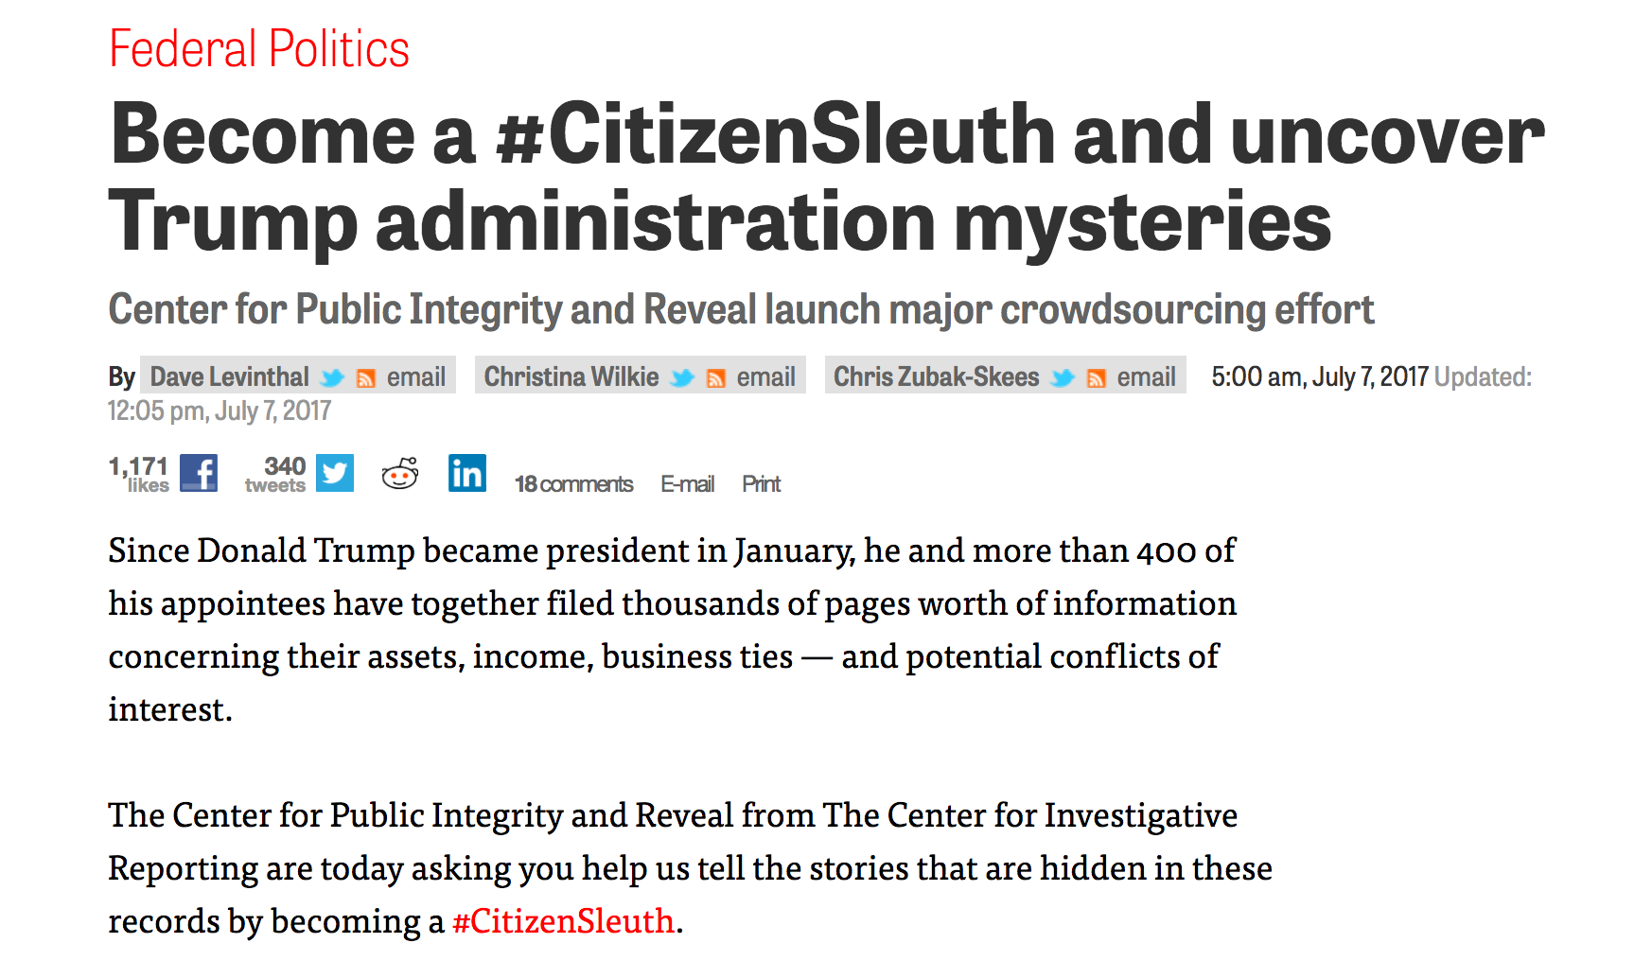
Sharing data
Notes:
Crowdsourcing research-heavy datasets is becoming increasingly popular

Slide 55
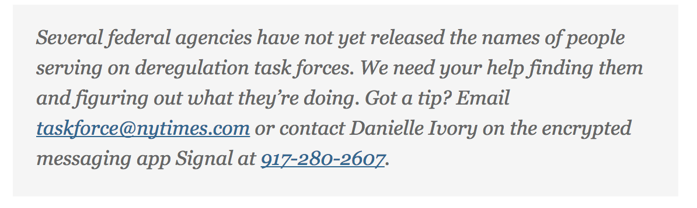
Sharing data
Notes:
Crowdsourcing research-heavy datasets is becoming increasingly popular

Slide 56
Sharing data
Crowdsourcing: Tips
Good documentation!
Make it clear what you want from people
Have some way of versioning any work people are doing
Think about trolls in advance
Notes:
Crowdsourcing research-heavy datasets is becoming increasingly popular

Slide 57
Sharing data
Crowdsourcing: Tips
Most importantly: remember that not every person out there has had journalistic training, so be thoughtful about releasing data or asking for help when individual safety is concerned
Notes:
Crowdsourcing research-heavy datasets is becoming increasingly popular

Slide 58
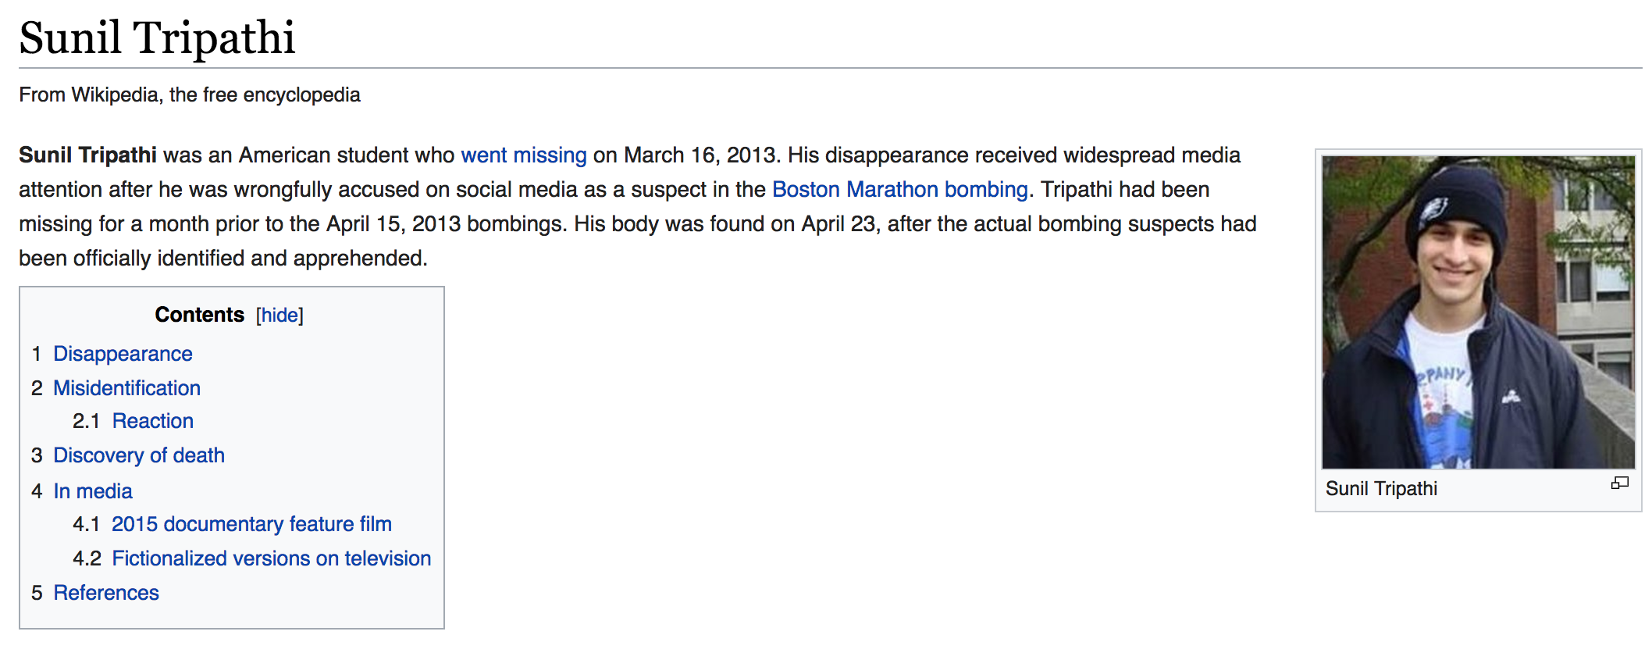
Sharing data
Notes:
Anyone remember this one?
No one in particular released this data or call for help - it all happened on Reddit.
It turns out he had committed suicide about a month prior to the boston marathon bombing, but some redditors incorrectly put together some clues and blamed the bombing on him. Obviously hard to prevent, but it’s a case to keep in mind when asking for help.

Slide 59
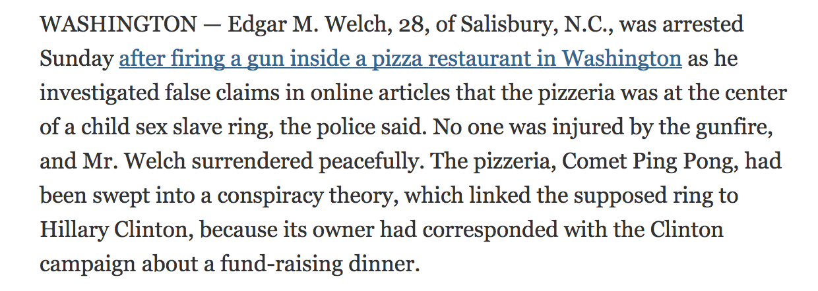
Sharing data
Notes:
How about this one?
Again, this wasn’t a request for help from mainstream media, but definitely a concern to keep in mind when asking for help investigating things. Folks with journalistic training rarely “self investigate” a situation with a firearm, but random people can.

Slide 60
How to collect data
What is most famous recent case of high profile data collection?
(Hint: it won a Pulitzer last year)

Slide 61
google slides will not let me insert this video :(
https://www.washingtonpost.com/video/c/embed/37075f2c-8ff5-11e6-bc00-1a9756d4111b

Slide 62
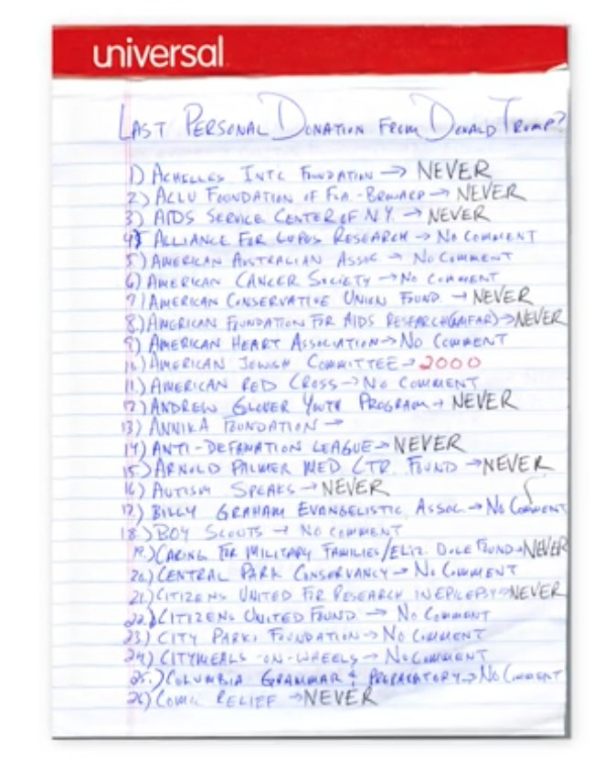
...but what if we want to search? Or find the most recent?

Slide 63
Collecting data with spreadsheets
These tips mostly come from this fantastic paper:
https://www.tandfonline.com/doi/full/10.1080/00031305.2017.1375989

Slide 64
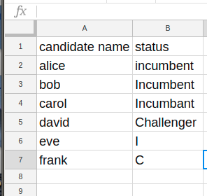
Be Consistent!
Come up with standard ways of coding things.
For example, let’s say you’re looking at political candidates and want to distinguish challengers from incumbents. Do not do this:
Notes:
Either use abbreviations or full words. Do not change capitolization. Don’t spell stuff wrong.
There’s actually an easy way to do this when you set up your sheet: data validation!
https://docs.google.com/spreadsheets/d/1yJ1vkJllLhdmSWVs7Ccl6mJu2QOZz8Tpmm1_B8eAO5M/edit#gid=0

Slide 65
Be Consistent (continued)
Pick a date format and stick to it!
I highly recommend YYYY-MM-DD, because then your dates will sort in the right order.
ALWAYS use zero-padded months and years.
Please ask about the time I did not do this with files I was generating every day and ended up with files with names like data_11217.csv and had no idea if it was Nov 2 or Jan 12.
Actually don’t ask it’ll just make me feel sad.
Notes:
Show sorting example. Spreadsheets are pretty smart about identifying dates and getting them right, but you have no idea when a collaborator might export the data and try to sort it using another program.

Slide 66
Blank cells
Think carefully about what to do about missing data.
The paper I cited recommends using a mark for missing data such as NA so you can distinguish missing data from data you haven’t yet filled in, and you don’t accidentally treat missing values as zeros.
I’m not sure I agree with this - it makes it hard to sum and do other math if you are prepared to be careful about missing data. So my way is a little more fast and loose, but might make your life easier.
Never ever EVER use zero or any other number for missing data.

Slide 67
Be consistent across files
Going to collect similar data in more than one sheet (eg the same dataset for different years?)
USE THE SAME HEADERS AND CONVENTIONS!!!

Slide 68
Naming things
Do not use spaces in names. Underscores or camel case is much better.
Underscore notation:
degrees_c; number_of_attendees; last_name
Camel case notation:
DegreesC; NumberOfAttendees; LastName
Do not use punctuation in names.

Slide 69
One thing per cell
Let’s say you’re interested in a person’s age and gender. NEVER PUT THEM IN THE SAME CELL!
An interesting question is whether first and last name or components of an address count as “more than one thing”. I would say first and last name is dealer’s choice (although if you do combine, you probably want lastname,firstname for sorting purposes). For address, definitely keep city, state and zip separate, in case you want to aggregate by one of these things.
Notes:
See example - what if I later decide I want all people under 30 - nearly impossible to find them without looking manually, whereas if they were in separate columns, I could sort!

Slide 70
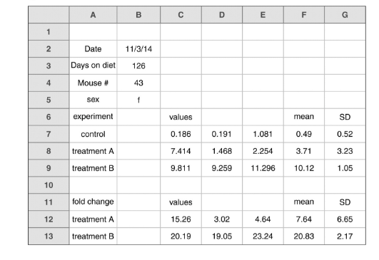
Your data should be a single rectangle
Sheets with data scattered all over the place or lots of different tables are nearly impossible to sort or analyze.
If you really need multiple rectangles, you probably need multiple sheets.

Slide 71
Data dictionary!
You should have documentation explaining field names and what you expect to find in them. This can just be another tab on your sheet or a text document, and mostly helps explain your fieldnames.
EG:
name: Full name in format lastname, firstname middlename
dob: birthdate in format YYYY-MM-DD
num_pets: the number of pets the person claimed to own; blank if they refused to respond

Slide 72
DO NOT use font color or highlighting
Well. Do not use it for significant reasons. Maybe during data exploration.
You’re unlikely to document what you mean
Font/color choices will disappear if anyone exports your data as a CSV
Don’t be mean to your colorblind friends
Font and color are not sortable
Instead, you should make another column with the thing you want
Notes:
See example
What does this mean? How do I sort it?
Add column for “age bucket”

